Slide 1
Your Health and Wellbeing
Lunch and Learn
19th Jan 2022

Slide 2
Today we will cover…
How you are?
Change and adapting
The importance of self care and self compassion
The importance of both physical and psychological health
LSCft approach to Health and Wellbeing
Support
Personal wellbeing

Slide 3
Trust commitment
We are working together to help people to help themselves to enjoy a healthy, happier and longer life. We recognise that balancing everyday life together with the requirements of work and home can create pressures for all of us; we value our people and understand the importance of looking after those that work for us.
Here are some of the things we encourage: Health Promotion – many of our teams have a Health and Wellbeing Champion Supporting Stress and Mental Wellbeing – we take a psychological first aid approach and offer reflective opportunities Healthy Lifestyle – encourage positive lifestyle choices, small changes can have a big impact on our health Recognise success – from saying ‘Well done’ to a colleague, to our annual Staff Awards’ and Shining Star initiative 5 Ways to Wellbeing - a set of evidence-based actions which we activity endorse and promote

Slide 4
How are you? How are you really?

Slide 5
Coronavirus and you
Your physical health
Your mental health
Your overall wellbeing

Slide 6
Bridge’s Transition Model
“It isn’t the changes that do you in, it’s the transitions. Change is situational, transition is the psychological process people go through to come to terms with the new situation. Change is external, transition is internal.”
William Bridge (1991)

Slide 7
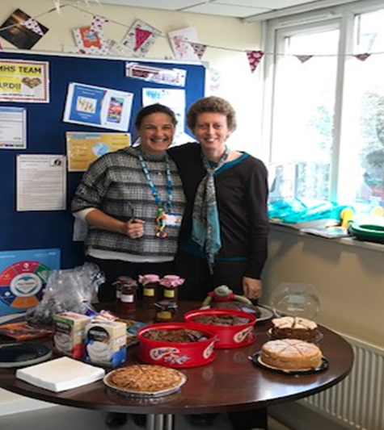
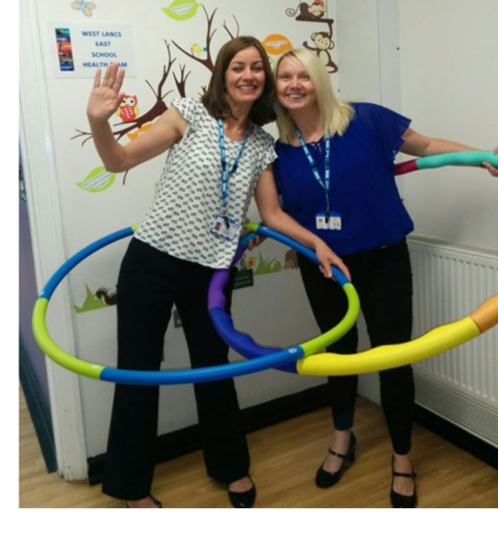

Slide 8
Physical and Psychological Health

Slide 9
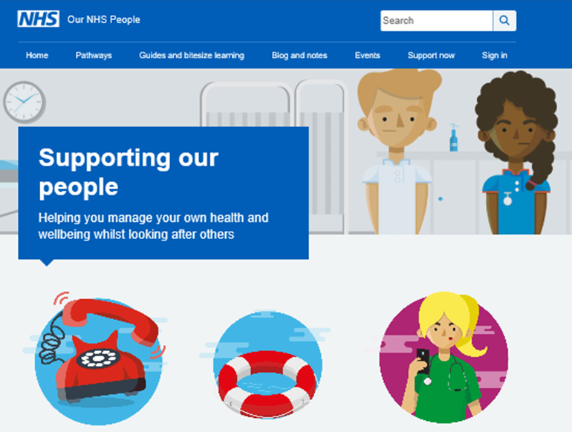
Support
Employee Assist
Programme
FREEPHONE
0800 028 0199
www.healthassuredeap.co.uk
Username: Lancashire
Password: Care

Slide 10
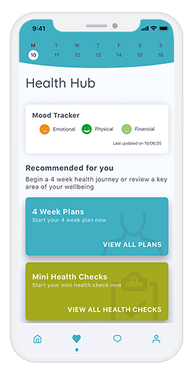
EAP App ‘My Healthy Advantage’
My Healthy Advantage app provides proactive wellbeing tools and engaging features to enhance existing services. Each feature has been carefully built with your wellbeing in mind. Designed to improve mental and physical health by utilising personal metrics to set bespoke goals and achievements
The App empowers users to:
Focus on their own wellbeing
Contribute towards a positive workplace culture
Comprehensive and accessible 24/7, 365
Access to exclusive perks and rewards
https://www.healthassured.org/my-healthy-advantage-wellbeing-wellness-app/
My Healthy Advantage App Code is MHA000135

Slide 11
Resources

Slide 12
Resilience

Slide 13
Self Care
Take action to remain healthy and well – mentally and physically
Treat our own charge as well as we do the charge in our mobile phones!
Physical and emotional wellbeing is paramount
As adults - caring for ourselves is our responsibility

Slide 14
Health and Wellbeing website
https://wellbeing.lscft.nhs.uk/

Slide 15
Support Jigsaw

Slide 16
Contact the Team
Health and Wellbeing Strategic Lead joanne.smith@lscft.nhs.uk
Health and Wellbeing OD Practitioner Jo.Moffet@lscft.nhs.uk
Health and Wellbeing Admin Co-ordinator Susan.Mortimer@lscft.nhs.uk
Health and Wellbeing Graduate Trainee Bethany.Bradshaw@lscft.nhs.uk
healthandwellbeing@lscft.nhs.uk

Slide 17
Thank you

